Slide 1
Amazon RDS for PostgreSQL – Backup and Restore
Fully managed relational database service
Notes:
Notes / talk track from ggrieff and similar to what’s available in this broadcast video -> https://broadcast.amazon.com/videos/308213. Please review and adjust for your delivery.

Slide 2
“Your backup is only as good as your last restore”
- Tom Kyte
“Everything fails all the time”
- Werner Vogels
Notes:
Here are a few more ideas to augment and customize your delivery of the immersion day content. Remember to also make the presentation and talk track your own. Cover the relevant topics but tailor it to your audience and your presentation style. One way to do that is to start or end with a few quotes. This can help make your delivery more dynamic and also provide a good way to summarize the importance of the topic. Here’s an example of a few quotes that I often open this presentation with, feel free to steel them of find ones of your own.

Slide 3

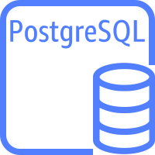


RDS for PostgreSQL - Snapshot Backup
Automated backups
Scheduled daily backup of entire instance
Up to 35 day retention for backups
Point-in-Time Recovery to any point in time during the backup retention period
Transaction logs uploaded to S3 every 5 minutes (recovery model set to full)
DB Instance state must be available
Manual Snapshots
You can also backup your DB instance manually by creating a DB snapshot
Can be used to create a new RDS instance
Retained until you delete
Region
Availability Zone #1
Transaction Logs
EBS Snapshot
DB
App
S3
Notes:
One of the expectations in using a managed service for your database is that routine tasks like backups are handled for your without a lot of heavy lifting for you or your team. And that is exactly what is delivered with RDS. RDS for PostgreSQL backups are facilitated through snapshots of the underlying elastic block storage volumes associated with your RDS database. Snapshot are just that ,a picture or image of your disk at a consistent point in time. The snapshots are stored in AWS S3 or Simple Storage Service our object storage service. Unlike buckets and objects you may create in S3, you don’t have access direct access to the bucket where the RDS snapshots are stored, you need to use the RDS console, CLI or API’s to interact with them. There are two types of backups used with RDS PostgreSQL. First is automated backups, as they name implies these are automatically facilitated for you, again we handle the heaving lifting of setting this up when you create your RDS instance. You’ll just specify a few items configuring how automatic backups operate when you create, or later if modifying your RDS database. These include the retention period for the backups which can be set to between 1 and 35 days. As the name implies this determine how far in the past you can restore your databse. Optionally you can also you’ll also specify a backup window to determine when each day the backup should begin. If you don’t specify a backup window one is selected for you and assigned to your databases. Like the database snapshots, transaction logs are also saved out to S3 every 5 minutes. With the automated backup snapshot and transaction logs your are able to recover your database to any point in time within the backup retention period.
The 2nd type of backup you can preform with RDS Postgres databases are manual snapshots. Just like the automated backups a manual snapshot creates a consistent image of the EBS volumes associated with your database and is saved to S3. However they are created whenever you or trigger them. You can create a new RDS instance from both automatic backups or manual snapshots but there are some important differences between them. Let’s take a look at a comparison.

Slide 4
Automated vs. Manual Snapshot
Automated Snapshot
Manual snapshot
Automatically created daily (user configured backup window).
Kept until outside of window (35-day maximum) or instance is deleted
Supports PITR
Good for disaster recovery
Manually created through AWS console, AWS CLI, or Amazon RDS API
Kept until you delete them
Restores to saved snapshot
Use for checkpoint before making large changes, non-production/test environments, final copy before deleting a database or backups that need to be retained for compliance reasons
Notes:
Automated backups are created daily during a backup window whereas manual snapshots are created when you trigger them – through the console or an API call. Automated backups are governed by a rolling retention window so they only stick around until they expire out of the window – 35 days at the most. Manual snapshots on the other hand stick around until you delete them. So you can have a backup from 2+ years ago. Its important to understand this from a cost management standpoint, you only want to keep manual snapshots that you have later need for, so you want to periodically check if there are manual snapshots you can purge so as to optimize costs. One full backup of the database is included with the RDS instance and associated storage costs, but you will pay for the storage of additional database backups. Like automated backups the transaction logs that are saved out to S3 are subject to the same rolling backup window and will expire. Your are able to recover to a particular point in time using your automated backup and rolling it forward with the transaction logs up through the retention period. A common situation for taking a manual snapshot is just prior to a database upgrade, or software release; so you have a known point to which you may want to restore – perhaps to rollback a software update.

Slide 5
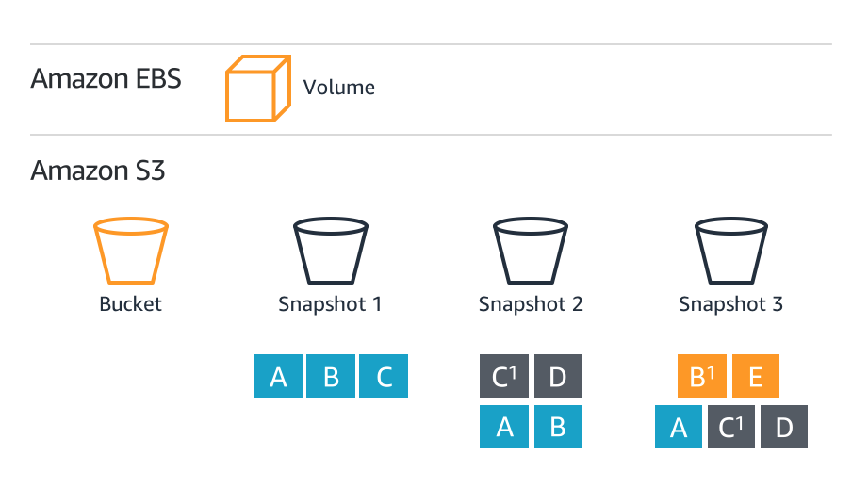
RDS for PostgreSQL - EBS Snapshot Backups of your entire database instance in Amazon S3
RDS Host = EC2 instance with an EBS volume
Backups always incremental
Amazon S3 → 99.999999999% durability
Inherits encryption
Copy across accounts
Copy across regions -- DR
Copy automatic to manual – long term retention, beyond 35 days
Notes:
In this slide we want to have a deeper look under the hood with how database backups are facilitated through snapshots. There are a number of key takeaways here but chief among them is the incremental nature of database backups using snapshots. An RDS database is nothing more that an EC2 instances and EBS volume. Database backups are the same as a snapshot of an EBS volume. The incremental nature of snapshot backups means that you never need to read more than the number of blocks that make up the volume to restore it.
We have our EBS volume containing our database, and as we said this is going to be automatically backed up database as part of the RDS managed service. So during our first snapshot our database is made up of blocks A, B, and C and since this our first backup we need to copy them each to S3. As the day rolls around we see that block C was updated and we added a new block, block D, so for this snapshot I only need to backup those two blocks I can simply reference unchanged blocks A and B from the prior days snapshot. The next day we see that block B was updated and we added block E, so again I only need to backup those two blocks and I can reference the early snapshots for the unchanged blocks. The incremental nature of backups in this manner means the are very efficient.
Remember the snapshots are stored in S3 to they inherit the 11 9’s of durability. The snapshot backups will inherit the encryption of the database; so if you database is encrypted your snapshot backups will be encrypted – you don’t need to do anything special. You are able to copy an automatic backup to a manual snapshot to preserve them beyond the specified database retention window. You are also able to copy snapshots from one account to another or one region to another. Keep in mind there will be data transfer charges associated with cross regions copies. But this can be a very use technique for disaster recovery scenarios.

Slide 6
Conventional database backups
Sun
Mon
Tue
Wed
Thu
Fri
Sat
Full
Diff
Incremental
Diff
Incremental
Cumm
Incremental
Diff
Incremental
Diff
Incremental
Cumm
Incremental
Restore Wed Afternoon
Restore Sat Afternoon
Restore Mon Morning
Full
Cumm
Incremental
Diff
Incremental
Diff
Incremental
Notes:
Optional: Use these next few slides with animations to better describe the advantages of snapshot backups.
Let’s take a look back in time review how conventional backups would take place. Say we have a sizable many terabyte database and we’ve setup a weekly backup schedule. On Sunday evening we will take a full backup. Through the day on Monday we generate a series of logs detailing the changes to our database. On Monday we take an incremental differential backup, only grabbing the blocks that changed since our full on Sunday. Tuesday same thing and incremental differential of the blocks that changed since Monday. On Wednesday we take a cumulative incremental, so looking back to Sunday grab all the blocks that changed since that backup. Thursday / Friday differential incrementals – and of course the logs generated so we are able to roll forward. Say Saturday night we do another cumulative incremental. So now let’s look at a restore we need to preform on Monday. This is good, we just have to restore Sunday’s full and apply the logs.

Slide 7
Incremental backups
Non Optimal Case
Optimal Case
10× more work
1
2
3
4
5
6
7
8
9
10
Database blocks
Notes:
Database are made up of blocks, from a backup perspective the smallest unit we work on is a database block. Let’s look at how this can vary. If we look at the optimal case we write our first change to block one, and the subsequent changes that day all affect block one. SO when we go to do our incremental backup we only need to grab block one. But now let’s look at the non-optimal case. Again our first write goes to block one but subsequent writes occur across all 10 blocks, so now our incremental need to grab all 10 blocks.

Slide 8
Conventional database backups: Non-optimal
Sun
Mon
Tue
Wed
Thu
Fri
Sat
Full
Diff
Incremental
Diff
Incremental
Cumm
Incremental
Diff
Incremental
Diff
Incremental
Cumm
Incremental
Restore Sat afternoon
Full
Cumm
Incremental
Diff
Incremental
Diff
Incremental
3× more work
=
3× recovery time

Slide 9
Amazon RDS backups
Sun
Mon
Tue
Wed
Thu
Fri
Sat
1 | 2 | 3 | 4
5 | 6 | 7 | 8
9 | 10 | 11 | 12
13 | 14 | 15 | 16
1 | 2 | 3 | 4
5 | 6 | 7 | 8
9 | 10 | 11 | 12
13 | 14 | 15 | 16
1 | 2 | 3 | 4
5 | 6 | 7 | 8
9 | 10 | 11 | 12
13 | 14 | 15 | 16
1 | 2 | 3 | 4
5 | 6 | 7 | 8
9 | 10 | 11 | 12
13 | 14 | 15 | 16
1 | 2 | 3 | 4
5 | 6 | 7 | 8
9 | 10 | 11 | 12
13 | 14 | 15 | 16
1 | 2 | 3 | 4
5 | 6 | 7 | 8
9 | 10 | 11 | 12
13 | 14 | 15 | 16
1 | 2 | 3 | 4
5 | 6 | 7 | 8
9 | 10 | 11 | 12
13 | 14 | 15 | 16
Restore Sat afternoon
Restore Wed Afternoon
1 | 2 | 3 | 4
5 | 6 | 7 | 8
9 | 10 | 11 | 12
13 | 14 | 15 | 16
Fixed time for EBS storage Variable for WAL logs
Notes:
So let’s look how this works in RDS. RDS is backed by EBS, so we have this managed service to provide snapshots of our volumes. If we look at this same scenario across the week. Let’s ay we have a database with 16 blocks. Sunday we take a snapshot and we have a copy of all 16 blocks. Through the day on Monday we dirty 2 block, so we back them up in an incremental. Tuesday… Is this

Slide 10
RDS for PostgreSQL – Working with Backup
Set retention to positive a value to enable automatic backup [Retention Limits 1 – 35 days; default of 7 days]
Take manual snapshots to reduce PiTR replay window
Storage I/O suspended briefly for single AZ instances during backup (typically under a few seconds)
You may experience elevated latency for a few seconds during backup
Set backup window to low-usage time
Notes:
To enable automated backups you need to set your retention window to between 1 and 35 days. By default the retention period is set to 7 days. Keep in mind you will pay additional costs for backup storage beyond one full copy of the database, so if you don’t have a need to recover beyond 3 days, don’t arbitrarily set your retention period to 35 days, that just unnecessarily costing you money. While nearly every database should set the retention windows to between 1 – 35 days there are some special cases where you might want to set retention to 0 disabling automated backups. Doing so will mean the database won’t archive the WAL logs, which can speed up DML – but your database will not be recoverable; so you only want to do this where database is easily re-created perhaps as part of an ETL pipeline process.
If you have a very busy system that generates a large amount of WAL log, you may want to consider taking additional manual snapshots each day. When considering your recovery time objective, you may need to apply 23+ hours of transaction logs if you only have your daily automated backup. Adding in manual snapshots every 4 hours, means that you would only need to apply up to 4 hours of WAL logs to restore your database.
For single AZ instances there are a few other considerations. First there may be a brief (couple second) suspension of I/O as the snapshot is initiated and the disk is quiesed to ensure consistency. You may also see elevated latecy during the backup as those I/O’s compete with your database activity, so you want to be intentional in setting your backup window to a low-usage time. These considerations are mostly alleviated with a multi-AZ RDS database, since the backup occurs on the secondary node.

Slide 11




RDS for PostgreSQL Multi-AZ Backup Architecture
Region 1
Multi-AZ databases use synchronous writes.
When using Multi-AZ, database snapshots are taken on the standby database.
The transaction logs from the primary database are written to S3
Snapshots can be copied across regions to support DR scenarios
Availability Zone #1
Transaction Logs
Availability Zone #2
S3
DB Snapshot
DB
App
Copy Snapshot to 2nd Region
Region 2
S3
Notes:
Remember we learned that in a multi-AZ RDS database writes are synchronous. Meaning the acknowledgement of the successful write ensures that its written to both the primary and secondary RDS instances. The ensure that the primary and secondary database are always exactly in sync and that allows us to take our snapshot backups from the secondary instance’s EBS volume. That snapshot is stored in S3. Additionally the database transaction logs are written out to S3 every 5 minutes. Combining them we have the ability to restore our database to any point in time within the retention window. And, we are able to copy manual snapshots to a 2nd region as a disaster recover option, for example.

Slide 12
Copying & Sharing Snapshots
With Amazon RDS, you can copy automated or manual DB snapshots. After you copy a snapshot, the copy is a manual snapshot.
You can copy a snapshot within the same region, you can copy a snapshot across regions, and you can copy a snapshot across accounts.
Copying an automated snapshot to another AWS account is a two-step process: You first create a manual snapshot from the automated snapshot, and then you copy the manual snapshot to the other account.
Copying Shared Snapshots
You can copy snapshots shared to you by other AWS accounts. If you are copying and encrypted snapshot that has been shared from another AWS account, within the same region, you must have access to the KMS encryption key that was used to encrypt the snapshot.
Notes:
You can copy automated backups or manual snapshots. That copy is then a manual snapshot – which means it lives until you explicitly delete it. Snapshot copies can be within the same region, across regions or across different account. You can only copy manual snapshots to another account, so copying an automated backup is really a two step process, first you need to copy the automated backup’s snapshot to a manual snapshot, then copy that manual snapshot to a 2nd account. Finally when you copy a snapshot of an encrypted database, you need to also share the encryption key. The default RDS encryption key cannot be shared with another account, so in order to copy an encrypted snapshot it must be encrypted with a customer managed key.

Slide 13

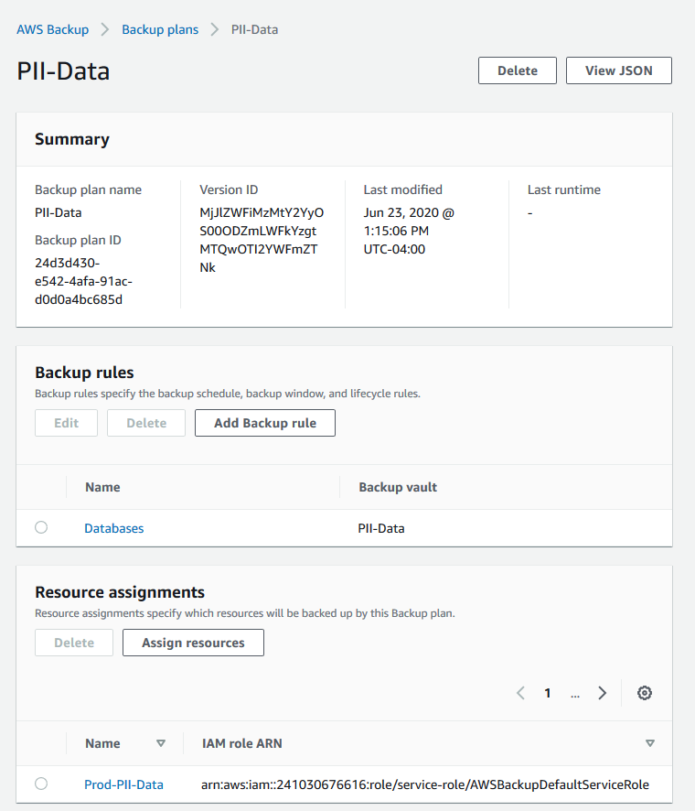
RDS Backups with AWS Backup Service
In addition to managing backups with the RDS Console, you can use the AWS Backup service to centrally manage your backups across AWS services including RDS.
Use tag-based backup policies to group application and database resource backups into a single process.
Use tags to discover newly created databases and ensure they are backed up according to your organizations governance standards
Limit access using backup vaults
Supports KMS encryption keys
Copy backups to another region for DR
Notes:
Automated backups and manual snapshots from within the RDS service are not the only means of backing up an RDS database. You can also use the AWS backup service to create backups of your RDS database. These backups are EBS snapshots just like those run from within the RDS service itself. There are a couple of reasons we see customers use AWS Backup in addition to automated RDS backups. First is to backup related EC2 instances and an RDS database with a consistent backup job. AWS Backup also can work based on tags, the can help ensure that newly created database with a given tag get backed up based on your organizations governance standards. AWS Backup also provides a nice method of copying backups to another region for DR purposes.

Slide 14
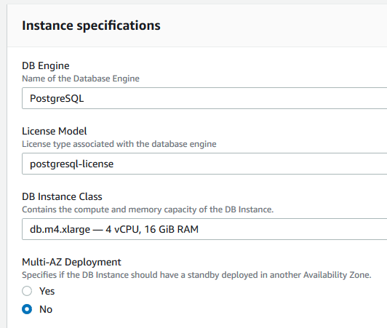

Restore from Snapshot
Restore from any snapshot
Creates a new RDS Instance
Copy snapshots within region, across, or to other user accounts
Storage type of the new database instance can be changed
(Note: leads to slower restoration process )
Refresh test environments
Test upgrades
Instantiate logical replicas
Original Instance
RestoreDBInstance FromDBSnapshot
Snapshot
New
Instance
Notes:
Ok so that pretty exhaustively covered the backup portion of this presentation, lets take a look at the restore portion. You can restore from any snapshot whether they are manual snapshots or those created through automated backups. A key thing to point out with restore is doing so ALWAYS creates a new RDS database, you are never doing anything to the original RDS Postgres database. This means that you are able to change properties of the database when you restore, whether its choosing a different instance family or size, changing encryption, or moving to different storage (note that last option may elongate the creation time). There are a number or reasons to restore a database like we discussed at the beginning of the presentation, creating a production copy to reproduce a problem, to test the impact of an update for example reviewing the impact of an instance family change like moving to Graviton on query performance, or even to instantiate a PostgreSQL logical replica.

Slide 15
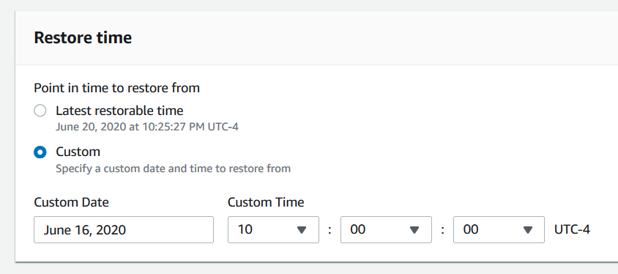
Point in Time Restore (PITR)
Required: full recovery mode
Restore to any second in backup retention
Available in-region/account
Latest restorable time typically <5 minutes
Oops… I dropped a table
Recover from application errors or logical corruption
Original Instance
RestoreDBInstance FromDBSnapshot
Transaction Logs
Snapshot
New
Instance
Notes:
A snapshot restore will restore the database the point the snapshot was taken. You can also initiate a point in time restore for a database, but again this is only possible to a point in time within the retention window. In doing so you can select a previous time, or the latest restorable time, which is typically less than 5 minutes. You are able to restore to a time down to the second. A common use of PIT restore is to recover from user errors like I mistakenly dropped a table

Slide 16
Restore via AWS Command Line Interface (CLI)
The AWS CLI can be used to programmatically perform the same functions as the console, like PiTR.
Incorporate into a script to preform scheduled refresh of a stage environment
Calls are asynchronous, so a callback to determine status is required.
aws rds restore-db-instance-to-point-in-time \
--source-db-instance-identifier rds-pg-db \
--target-db-instance restored-rds-pg-db \
--restore-time 2020-06-12T23:45:00.000Z
{
"DBInstance": {
"AllocatedStorage": 20,
"DBInstanceArn": "arn:aws:rds:us-east-1:123456789012:db:restored-rds-pg-db",
"DBInstanceStatus": "creating",
"DBInstanceIdentifier": "restored-rds-pg-db",
...some output truncated...
}
}
Notes:
Here we highlight that all functionality available in the RDS console is also available in the CLI or via API calls. This show a CLI command to restore a database to a given point in time. Using the CLI to orchestrate RDS commands allows you to script functions like triggering a manual snapshot ahead of a software release. Keep in mine that CLI calls are asynchronous, so you will need to pole for status completion where dependency of completion is necessary prior to the next step in a script. Another common use case we see customer use is a daily clone or restore of their staging system from a production copy.

Slide 17


RDS for PostgreSQL – Working with Restore
In addition to automated backups and manual snapshots you can use native PostgreSQL tools (pg_dump & pg_restore) to backup, restore and migrate data.
New volumes are hydrated from Amazon S3
While the volume is usable immediately, full performance requires the volume to warm up until fully instantiated
Migrate to a DB instance class with high I/O capacity
Maximize I/O during restore process
Notes:
In addition to automated backup and manual snapshots at the end of the day your RDS Postgres database is that – a Postgres database. That means that native tools like pgdump and pgrestore work just like the would for an onpremise database. These tools can be used in a complementary fashion, providing an alternative way to recover from user errors, for example. Another way pgdump could be useful is when restoring a database. Newly restored database volumes are hydrated from S3, and while they are immediately available, there is a warm up period until they are fully instantiated. Running pgdump against the new database is a way force that warm up prior to making it available to users.

Slide 18
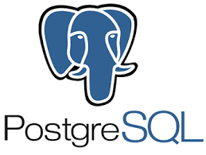
Backup/Restore with Native Tools
pg_dump
Logical backup: SQL with DDL & DML to regenerate database
Internally consistent backup from the point its run. Non-blocking
Operates on a single database. Use pg_dumpall for all databases
Dumps can be restored into newer PostgreSQL versions or across platforms
Restore by redirecting output into psql
pg_dump –Fc myrds.rds.amazonaws.com –p 5432 my_db > my_db.dump
psql < my_db.dump
pg_restore
Used with pg_dump archive formats (custom, directory, tar)
pg_restore –d new_db my_db.dump
Notes:
Pg_dump creates a logical backup of our database, essentially it generates the SQL statements needed to recreated your database. In Postgres a single RDS Postgres instance can contain many databases. Pg_dump operates on a single database. This can be attractive to help isolate backups of just a single database. So rather than needing to restored the entire RDS Instance your can selectively backup and restore just a single Postgres database from within the instance. Furthermore the logical nature of the backups me that can be restored into different Postgres versions or across different platforms. Pg_dump files can be restored by redirecting the dump file into a psql command. Alternately when pg_dump is used with one of the archive formats you can use pg_restore to restore the database.

Slide 19
Transportable Databases
Released in late 2019, Transportable Database for Amazon RDS for PostgreSQL allows you to move databases between RDS instances.
Supported in Postgres version 10.10+ or 11.5+
High speed data export / import
Uses the pg_transport extension
Can use a pull model where the destination instance imports the data from a source instance
Often used to move or reorganize databases in a multi-tenant SaaS environment
Review limitations in the documentation:
https://docs.aws.amazon.com/AmazonRDS/latest/UserGuide/PostgreSQL.Procedural.Importing.html#PostgreSQL.TransportableDB
Notes:
Its always good to highlight some of the recent updates to the RDS service when you deliver an immersion day. This slide covers PosgreSQL transportable tablespaces. Take a look through some of the latest content in the database blog and consider mentioning some of these features. This helps to demonstrate the fast and continuous pace of innovation with AWS services. Its always good to include links to this content so when you close out your immersion day and share the content, customer will have this information available to them.

Slide 20
LAB
Notes:
Just a few more reminders before we close. Always take a look through the RDS documentation ahead of your immersion day, so you are in the best position possible to field custom questions. When objections come up try to dive deep and understand the customers requirements and work backwards from there. Before closing out the presentation, take a few minutes to re-cap the steps in the lab. That’s it for this session of RDS / Postgres train the tainer

